Slide 1
Analytics and Watson Experience Center of Competency- Churn prediction
By Marwa Talaat

Slide 2
Agenda
Introduction
Business understanding
Preprocessing
Data understanding and exploration
Prediction
Choosing prediction model
Evaluation
Addressed Question
What are the most important drivers of customer churn?
What are 2-3 recommendations for how WW can use this information to reduce customer churn in the future?

Slide 3
Introduction
Large number of customers = high profits.
Gain new customer.
High cost and nearly impossible.
Reduce churn in existing customer
lower cost and building loyalty benefits.

Slide 4
introduction cont.
Churn from company perspective:
Reasons that makes customer decide to churn.
Their required improvement.
Churn form customer perspective:
Figure out correlation between churn and customer details such as age, address or details related to how they use services such as if they use internet service or not.
Identify high risk customers by building prediction model.
Target campaign to high risk customers.

Slide 5
Preprocessing – Data understanding
Data source consists of 1000 records and 22 variables.
It holds customers’ personal data such as age, region , and data about how they use the service such as voice and ebill.
Description of some columns in data source:-
Ed → education.
Pager → wireless device.
Tenure → number of month stayed.
Tollfree → free telephone number.
There is no missing data.
Most of columns’ data are flags (0/1)

Slide 6
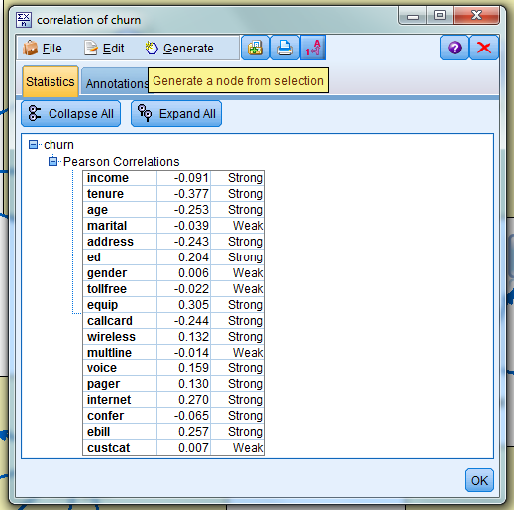
Preprocessing – Data exploration
According to business understanding, there are several factors/attributes affecting customer churn.
Therefore, we have to find correlation between churn and attributes.
Weak correlation will be neglected.
Strong will be considered .
With SPSS modeler, we will calculate correlation between churn and other attributes.

Slide 7
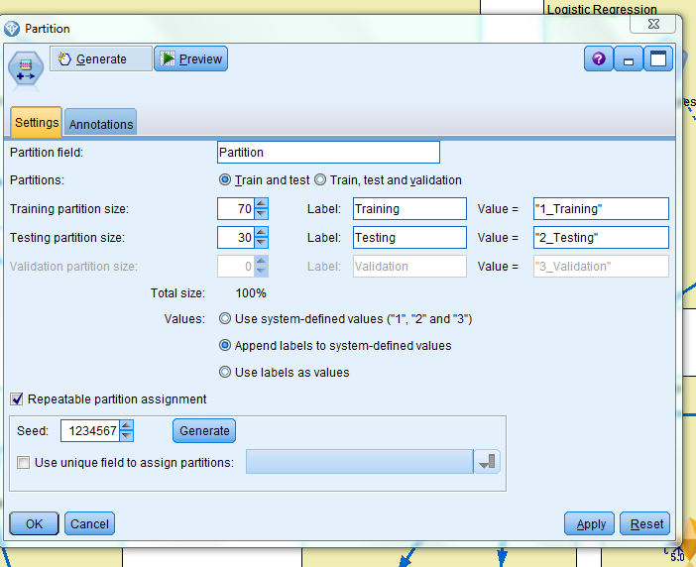
Prediction
Our target is to predict churn class (0/1).
Firstly we have to create testing and training set for data modeling.
We will split data into 70% training and 30% testing.
With SPSS modeler, we will use partition node.

Slide 8
Prediction
According to business understanding, we will have three main churn prediction model:
Logistic Regression.
Decision Tree.
SVM.

Slide 9
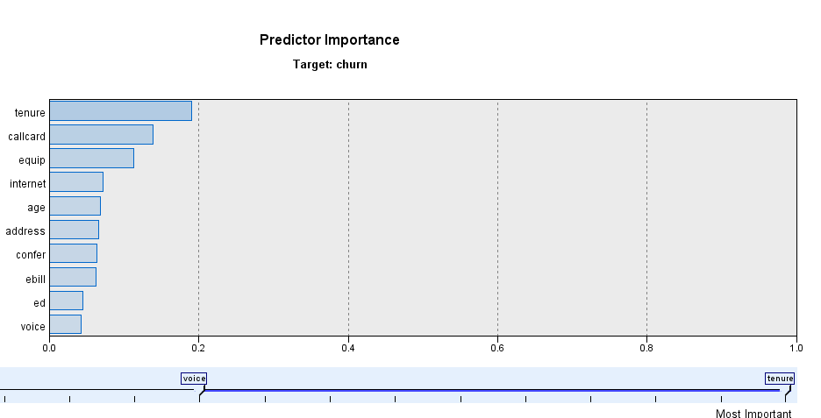
Prediction- logistic Regression
We will start with logistic regression.
On the training set we will perform logistic regression.
The accuracy level is 78.57% for logistic regression.
The following figure shows the most important features.
The most important features are tenure, callcard, equip and internet.

Slide 10
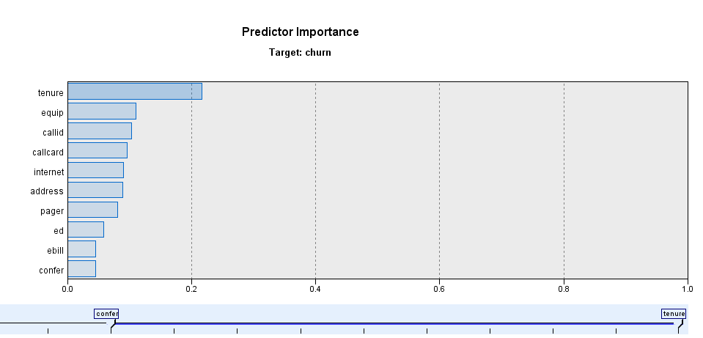
prediction- Decision Tree
On the training set we will perform decision tree.
The accuracy level is 84.43% for logistic regression.
The following figure shows the most important features.
The most important features are tenure, callid, callcard and internet.

Slide 11
Prediction-SVM
On the training set we will perform SVM.
The accuracy level is 89% for SVM.
Since SVM model has the highest accuracy level. We will perform evaluation on SVM.

Slide 12
Prediction-SVM
With analysis node in SPSS modeler. We can get model performance from AUC.
AUC tells how much model is capable of distinguishing between classes.
An excellent model has AUC near to the 1 which means it has good measure of separability.
In training set SVM’s AUC score is 0.937
In testing set SVM’s AUC score is 0.956
Therefore SVM is useful model to predict customer churn.

Slide 13
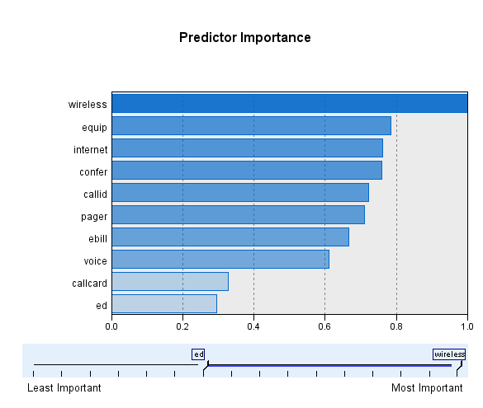
Customer clustering
We will be cluster customers according to how they use offering services. They will be divided into 5 clusters.
We will use k-means clustering algorithms.
According k-means the most important predictor as shown in following figure.

Slide 14
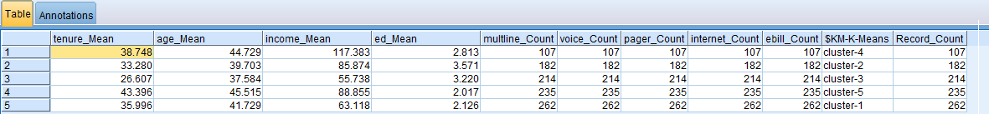
Customer clustering
Cluster-3: the younger age has small income, tends to subscribe in low cost services. They have low tenure rate
Cluster-5: the oldest age has large income, tends to subscribe in high cost services. They have large tenure rate
Cluster-1: the middle age has middle income, tends to subscribe in middle cost services. They have average tenure rate.

Slide 15
Suggestion to reduce churn rate
Since internet, confer, pager, equip and voice are most important predictors which drives customer churn. We suggest to improve business:
Cluster-3: since they are younger age they may interest in internet packages, so we can offer them some affordable packages. By performing simple query we found out that half of user under age 26 use internet and they churn to another operator, so we have to interduce offers to target this cluster.
Cluster-5: the oldest age group and they have large income tends to buy large packages which include conference calls to service their business as well as equip for his employees. as we found by operating query on this age range who employ more than 1. we found out more than 450 out of 1000 customers would benefit from this type of offers.
Cluster-1: Most of working class from middle age so they may need packages to service their work from internet and voice.

